Slide 1
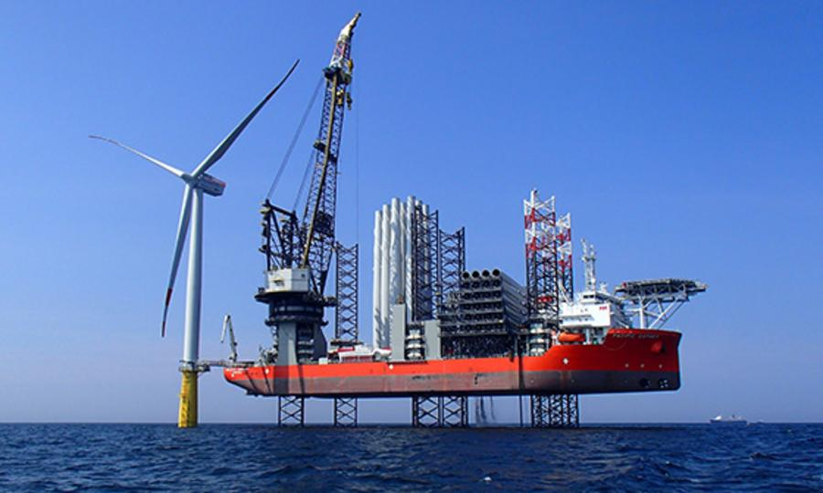
Presentation on
Offshore Wind Energy

Slide 2
The Climate Action Plan commits to increasing our offshore wind capacity to 3.5GW as part of our overall plan to reach at least 70% renewable energy by 2030.​
7 Offshore Projects have been designated Relevant Projects by the government and are in line to receive a valid grid connection offer
6 of these projects are in the Irish Sea
4 off the coast of Wicklow
Dublin Array RWE (2 projects Bray and Kish Banks)
Codling Wind Park (2 projects, Codling I and Codling II)

Slide 3
These projects are preparing to submit planning applications when the Marine Planning and Development Management Bill, 2020 is enacted in 2021
The expansion by SSE Renewables of the Arklow Bank wind Farm is proceeding under an extant permission but is engaged in public consultation and planning.
A non statutory public consultation process is also underway for the Dublin Array
Codling is proceeding with feasibility studies to identify an O&M base and have accelerated their planning processes.
There is at least one other wind farm under consideration for North Wexford
Each project is valued at between €1 and €2 billion

Slide 4
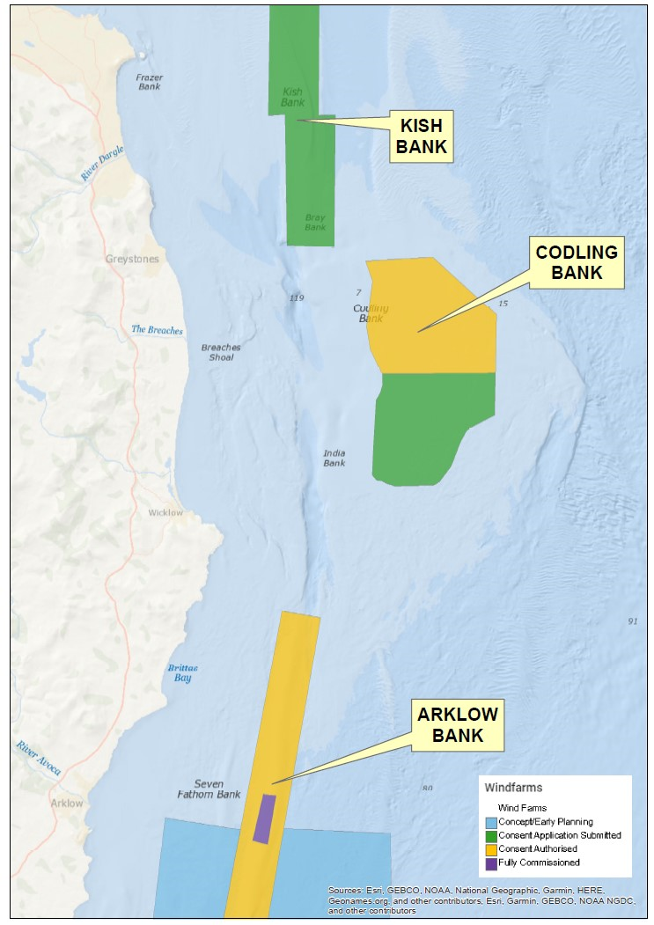

Slide 5
Key Milestones
The enactment of the Marine Planning and Development Management Bill, 2020 expected in 2021
The Renewable Energy Support Scheme (RESS) Auction whereby the companies bid for a grid connection is expected 2021
A mandatory Community Benefit Fund must be provided by all RESS projects of circa €2 per KW/hr

Slide 6
Dublin Array
45 to 61 Turbines off Killiney/Bray
Project Capacity 600 – 900 MW
Turbine Height 240 metres
Codling Bank Phase 1
220 turbines originally permitted between Greystones and Wicklow
There are likely to be fewer turbines than originally planned for
Capacity to power 400,000+ homes
Arklow Bank
Up to 200 turbines permitted - likely to be 76
Capacity to power 450,000 homes
7 turbines in place at present

Slide 7
Arklow Bank
Operations and Maintenance Base (O&M) selected in Arklow Harbour this will provide200+ jobs during construction and 80 jobs during operations phase
Public consultation on the offshore infrastructure and the onshore grid took place in Oct/Nov 2020
Application for consent to be submitted to An Bord Pleanala and DHPLG Dec 2020
Consultation on the O&M base to take place in 2021

Slide 8
Dublin Array
6 Week non statutory public engagement has been completed
Desk based analysis of data underway to determine environmental impacts prior to developing an Environmental Impact Assessment Report
Codling Bank
Team are assessing harbour facilities with a view to determining which is the most practical option for the O&M base

Slide 9
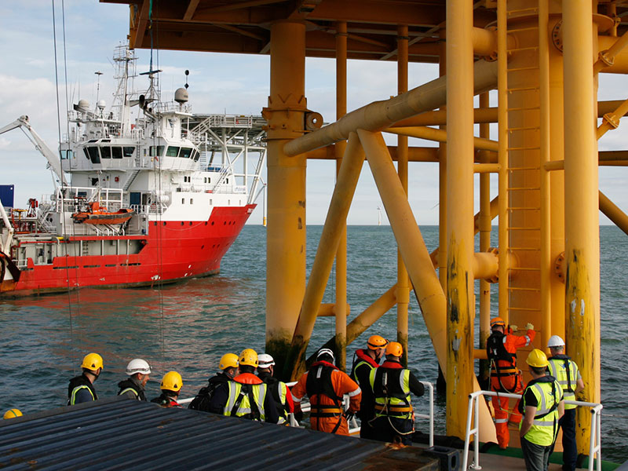

Slide 10
I
Irish Wind Energy Association Carbon Trust Report May 2020
Strategic investment must be directed urgently into one or more Irish ports on the east coast to develop offshore wind farms, including providing operations and maintenance support;
The Government must bring together industry, ports and local communities to develop offshore wind enterprise hubs to attract international investors and link them to Irish suppliers;
Continued support for Enterprise Ireland’s work on an offshore wind cluster for Irish companies to enable them to develop the skills and experience they need to compete in the British and European offshore wind markets;
Bring together schools, universities and training bodies to eliminate the skills gap and ensure that Irish workers can compete for the 2,500 construction – and 700 permanent – jobs that will be created just by achieving our 2030 targets.
Without investment not a single port in the Irish Republic will be capable of servicing the requirements to install an offshore wind farm and developers will be forced to look to ports such as Belfast or those on the British coast

Slide 12
WCC has a group: Maritime Business Development Group ( an initiative of County Wicklow Economic Think Tank)
Following developments and looking out for opportunities for County Wicklow

Slide 13
